Slide 1
Big Data Processing
Jiaul Paik
Lecture 4

Slide 2
Recap: Old Tools for Big Data Processing
Shared Memory
Message Passing
Programming models
Shared memory (pthreads)
Message passing (MPI)
Design Patterns
Master-slaves
Producer-consumer flows
Shared work queues
Memory
P₁
P₂
P₃
P₄
P₅
P₁
P₂
P₃
P₄
P₅
producer
consumer
master
work queue
slaves
producer
consumer

Slide 3
Some Difficulties
Concurrency is difficult to reason about
At the scale of datacenters and across datacenters
In the presence of failures
In terms of multiple interacting services
Debugging: Even more difficult
The reality:
Lots of one-off solutions, custom code
Write you own dedicated library, then program with it
Burden on the programmer to explicitly manage everything

Slide 4
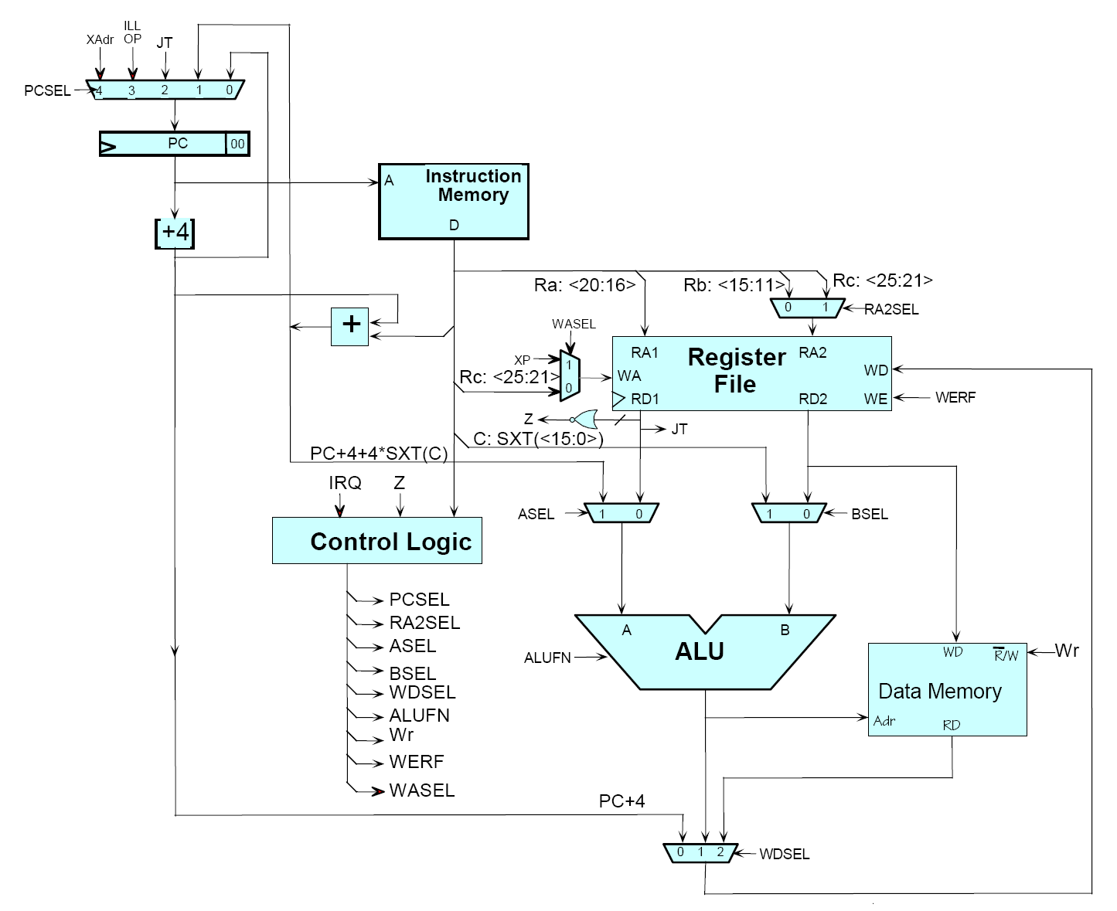
Source: MIT Open Courseware

Slide 5

Source: MIT Open Courseware

Slide 6
PRINCIPLES OF MODERN BIG DATA SYSTEMS

Slide 7
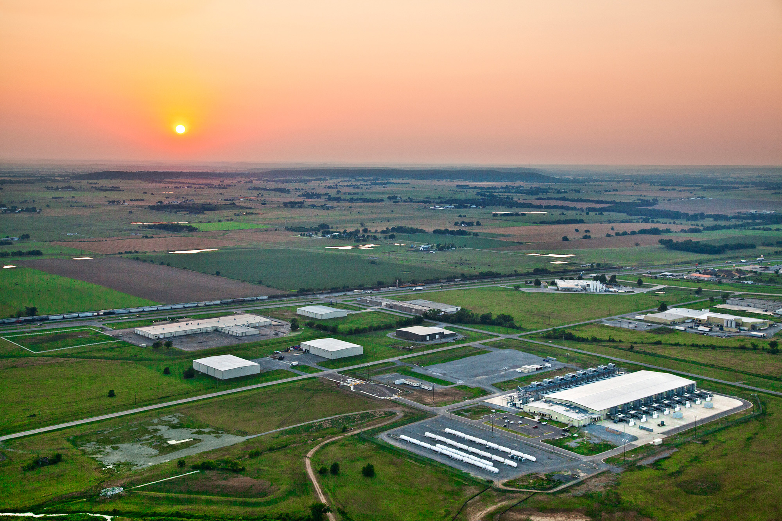
The Datacenter is the Computer!
Source: Google

Slide 8
The datacenter is the computer
It’s all about the right level of abstraction
Needs new “instruction set” for datacenter computers
Hide system-level details from the developers
No more race conditions, etc.
No need to explicitly worry about reliability, fault tolerance, etc.
Separating the what from the how
Developer specifies the computation that needs to be performed
Execution framework (“runtime”) handles actual execution

Slide 9
Bring computation to the data
data
data
data
code
code
Centralized processor
code
data
code
code
data
data
data
Traditional approach
Modern approach: Hadoop, spark

Slide 10

Key Idea for Big Data Processing Divide and Conquer
Source: Google Image search, clip art

Slide 11
Divide and Conquer
“Work”
Partition
w₁
w₂
w₃
worker
worker
worker
r₁
r₂
r₃
Combine
“Result”

Slide 12
BUILDING BLOCKS

Slide 13
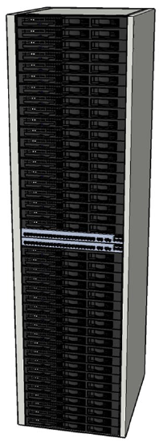
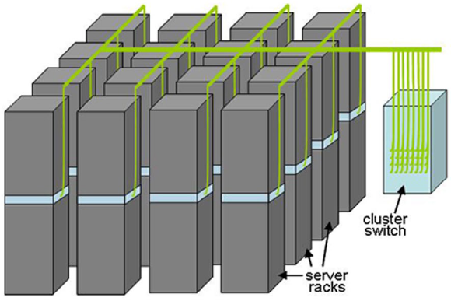
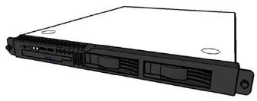
Building Blocks
Single
server
Rack of
servers
Cluster of racks
Source: Barroso and Urs Hölzle (2009)

Slide 14
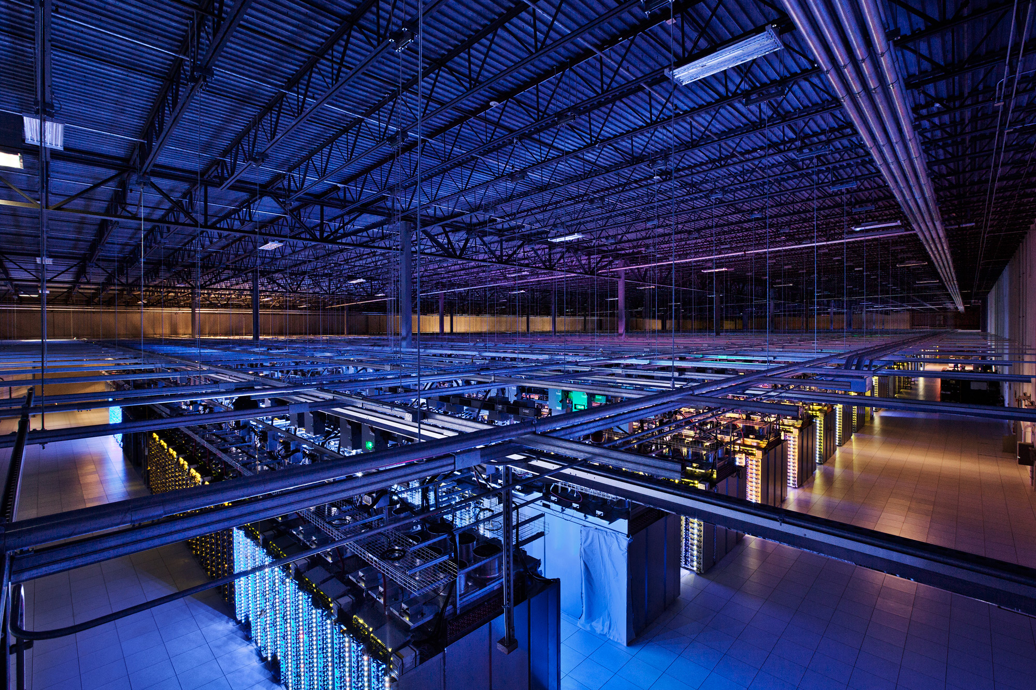
Source: Google

Slide 15
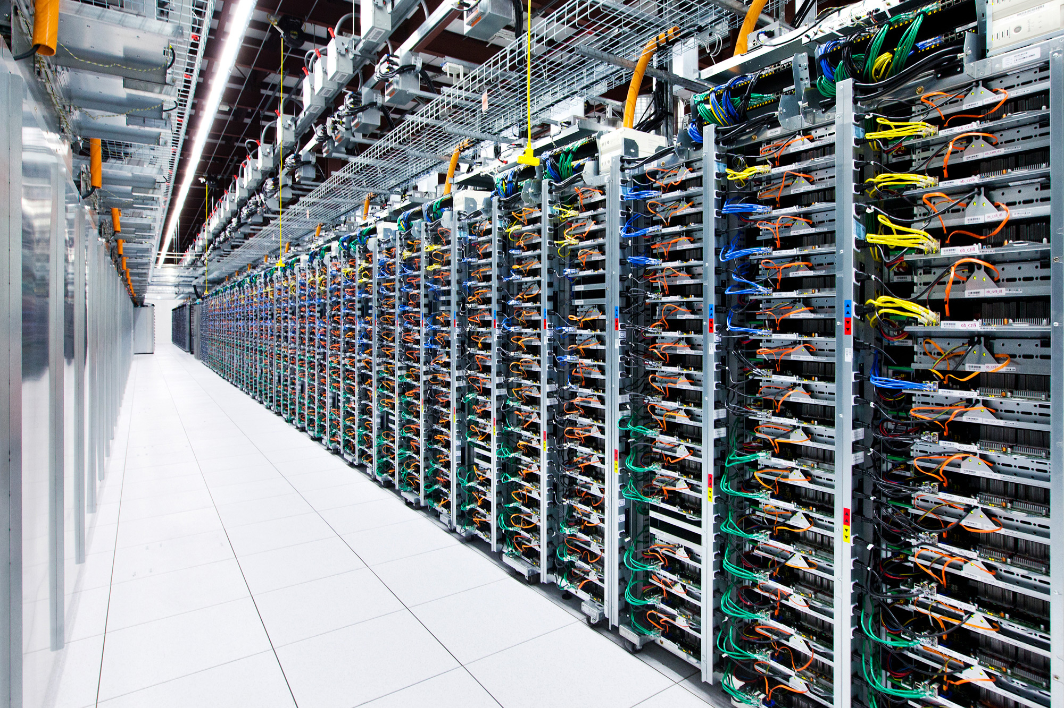
Source: Google

Slide 16
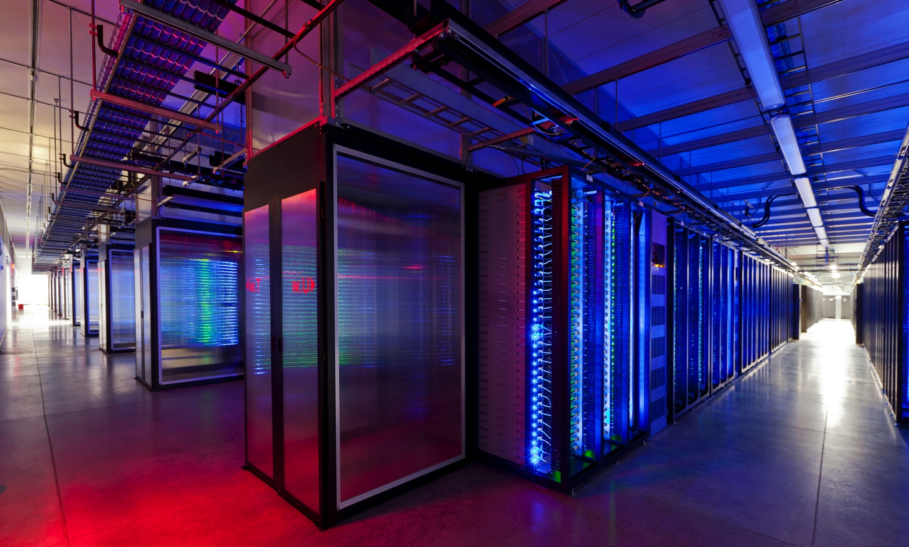
Source: Facebook

Slide 17
STORAGE HIERARCHY

Slide 18
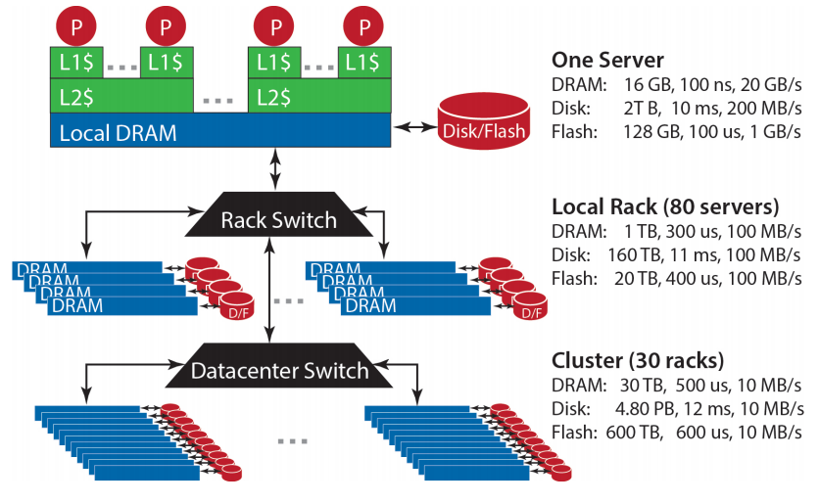
Storage Hierarchy
Source: Barroso and Urs Hölzle (2013)

Slide 19
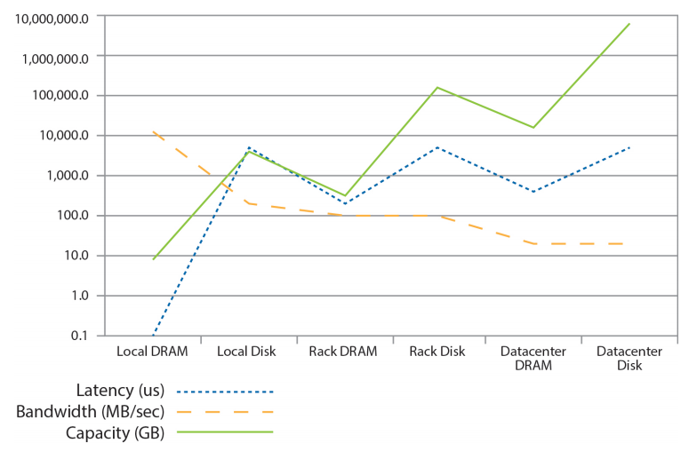
Storage Hierarchy
Source: Barroso and Urs Hölzle (2013)

Slide 20
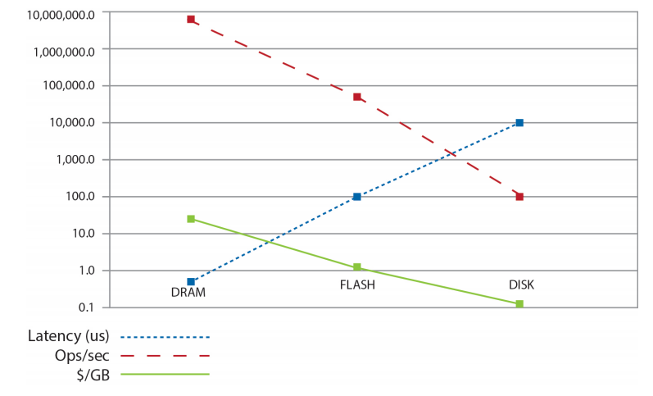
Storage Hierarchy
Source: Barroso and Urs Hölzle (2013)

Slide 21
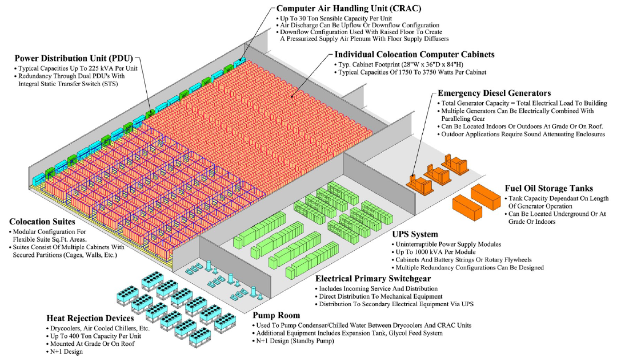
Anatomy of a Datacenter
Source: Barroso and Urs Hölzle (2013)

Slide 22
Why Cluster Computing for Big Data?

Slide 23
A Simple Problem: Word counting
You have 100 Billion web pages in millions of files. Your goal is to compute the count of each word appearing the collection.

Slide 24

Standard Solution
Use multiple interconnected machine
BIG DATA
1. Split data into small chunks
2. Send different chunks to
different machines and process
3. Collect the results from
different machines
Distributed Data processing in Cluster of Computers

Slide 25
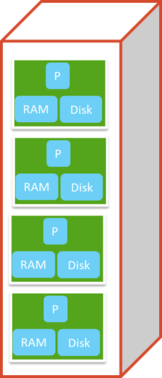
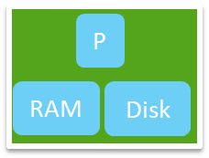
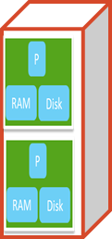
Compute Cluster Components
Rack
switch
server
Rack of servers
Data centre

Slide 26
How to Organize Cluster of Computers?

Slide 27
Cluster Architecture: Rack Servers
Backbone switch
(typically 2-10 gbps)
switch
1 gbps between any pair of nodes
switch
switch
computer
computer
computer
computer
Rack 1
Rack 2
Each rack typically contains commodity computers (nodes)

Slide 28
Key challenges in Cluster Computing

Slide 29
Challenge # 1
Node failures
Single server lifetime: 1000 days
1000 servers in a cluster => 1 failure/day
1M servers in clusters => 1000 failures/day

Slide 30
Consequences of Node Failure
Data loss
Node failure in the middle of long and expensive computation
Need to restart the computation from scratch

Slide 31
Challenge # 2
Network bottleneck
Computers in a cluster exchange data through network
Moving 10TB of data through 1 gbps network bandwidth takes 1 day

Slide 32
Challenge # 3
Distributed Programming is hard!!!
Why?
The programmer has to manage too many low level things apart from writing code for the task

Slide 33
Other Challenges
How do we assign work units to workers?
What if we have more work units than workers?
What if workers need to share partial results?
How do we aggregate partial results?
How do we know all the workers have finished?
What if workers die?

Slide 34
Managing Multiple Workers
Difficult because
We don’t know the order in which workers run
We don’t know when workers interrupt each other
We don’t know when workers need to communicate partial results
We don’t know the order in which workers access shared data
Thus, we need:
Semaphores (lock, unlock)
Conditional variables (wait, notify, broadcast)

